Slide 1
EBM HOMEWORK: clinical scenario, PICO QUESTION WITH THE BEST ANSWER
  By Sandra_Habka

Slide 2
CLINICAL SCENARIO:
A 50-year-old woman was diagnosed with migraine 2 years ago. She has been suffering from severe frequent attacks accompanied by nausea and a great sensitivity to light.
Recently, she had heard about botox injection treatment. She is in doubt about this kind of treatment but she really wanted the attacks to be less frequent. So she asked her neurologist about it.
The neurologist did his research.

Slide 3
Background question
What is migraine?
What are the symptoms of a migraine attacks?
What is Botox used to treat?

Slide 4
Foreground question
POPULATION:
Middle-aged woman with frequent migraine attacks.
INTERVENTION:
Botox injection.
p
i
Comparison:
Topiramate medication.
Outcome:
Prevent frequent migraine attacks.
c
o

Slide 5
Pico question
In middle-aged women (p) , Does the treatment with Botox injection (i) compared to topiramate medication (c) helps to prevent frequent migraine attacks in the future? (o)
Question type: Prognosis
Best evidence:
Systemic Review
Cohort

Slide 6
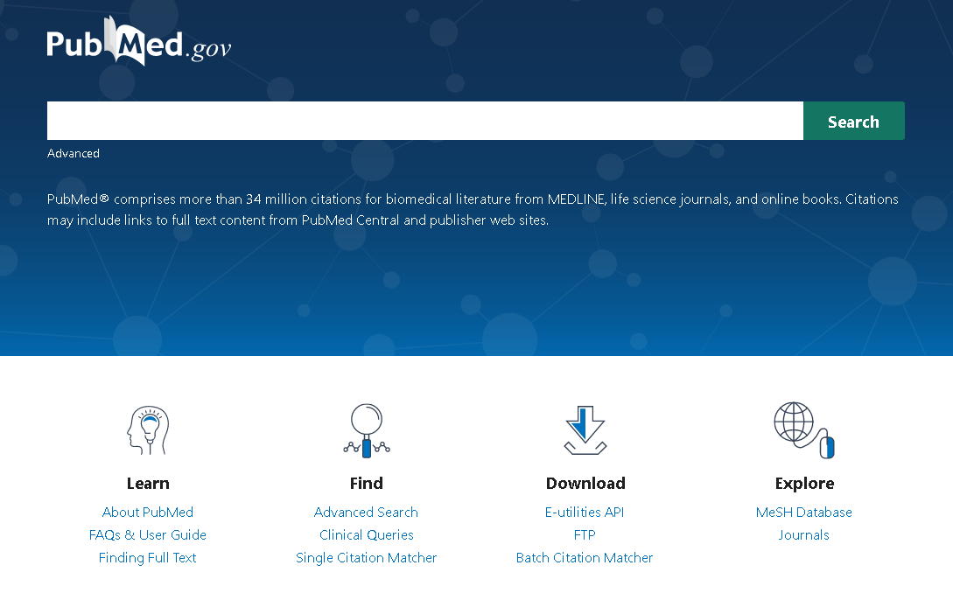
FINDING THE BEST ANSWER
We’ll be using MESH Database

Slide 7
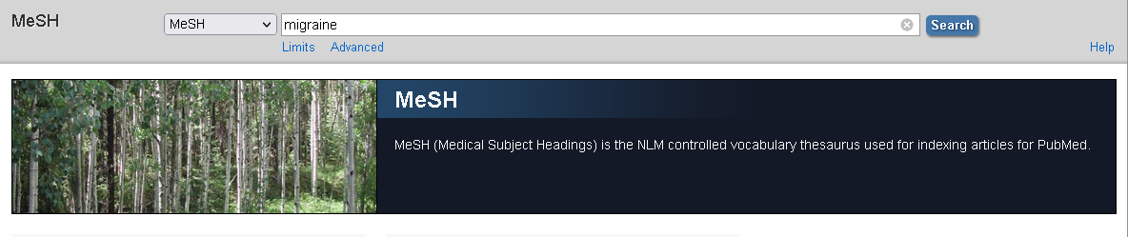
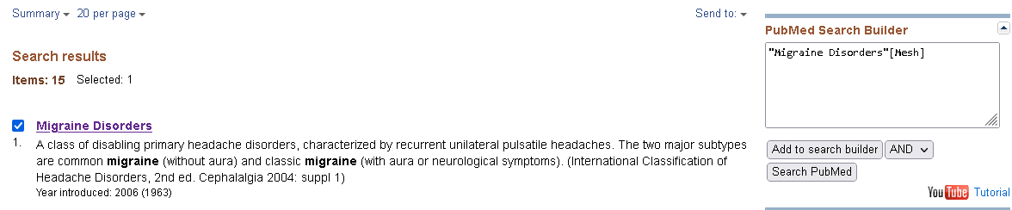
Type in the keywords you want to find in mesh terms
Choose the suitable term then type “add to search builder”

Slide 8
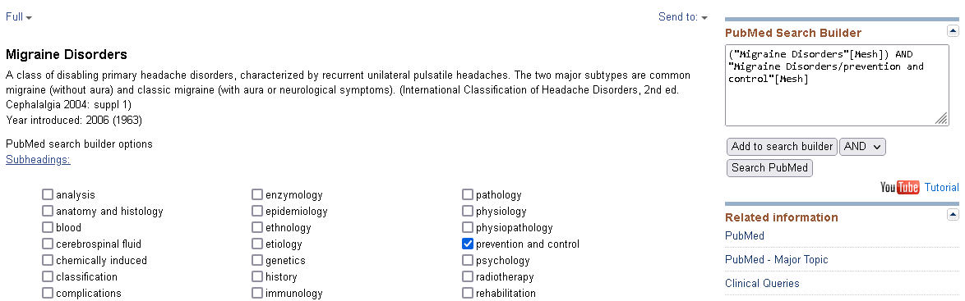
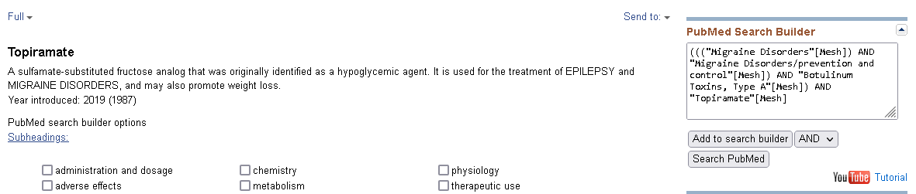
Add the subheadings you want
Continue to add the keywords you want, then type “search PubMed”

Slide 9
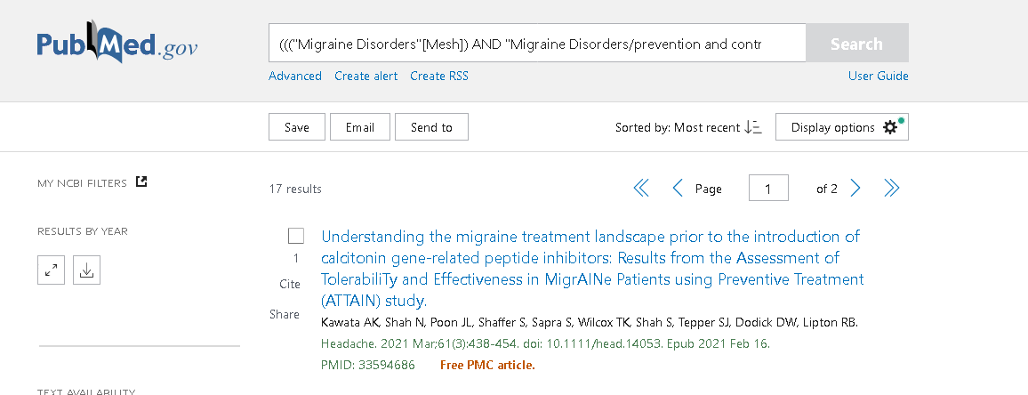
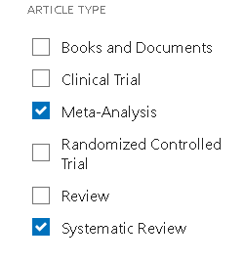
17 results appeared
Add the filters of the best Type of articles

Slide 10
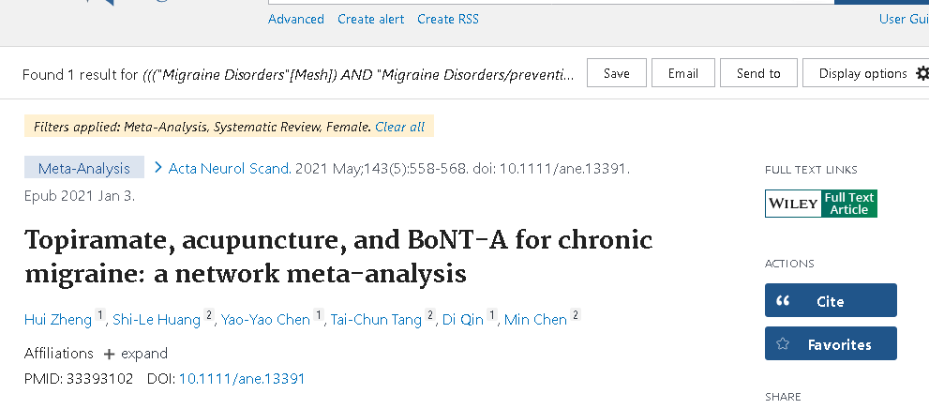

the results reduced to only one study.
The conclusion of the study

Slide 11

The best answer is
According to the study, Both topiramate and botulinumtoxinA can be used to reduce the frequency of migraine attacks, but botulinium toxin A or Botox shows more efficiency.

Slide 12
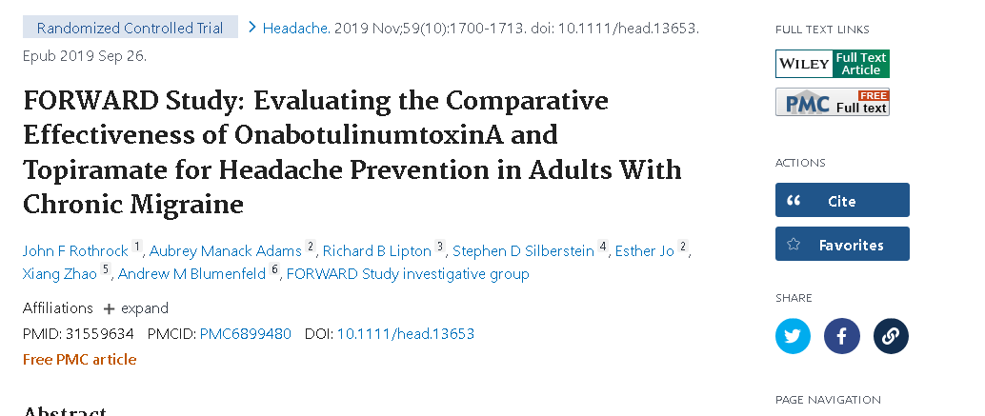
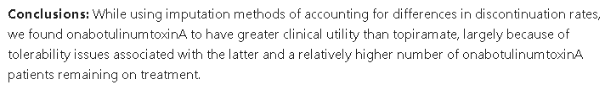
By adding RCT filter, another suitable study appears.
The conclusion of the study

Slide 13

Thank you

